Slide 1

Parallel and series connection of power supplies
Alfred Lorenz
FAE & Product Manager

Slide 2
Parallel and series connection of power supplies
Parallel and series connection of power supplies
Parallel and series connection differs from model to model
Some power suplies can easely work in parallel, others not. Also series connection is not as easy as it seems
From the following slides we will show you the most common methods for some TDK-Lambda power supplies
Read application notes and instruction manuals before connecting power supplies parallel or in series
Copyright© 2011 TDK Corporation. All rights reserved.

Slide 3
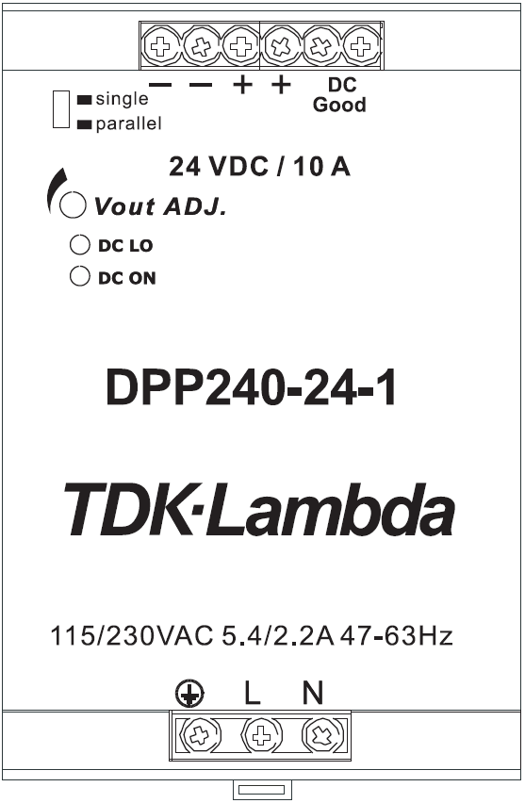
Connecting DPP100 - DPP480 1-phase models in parallel
Parallel connection of power supplies
First move the slide switches from "single" to “parallel” position
Adjust the output voltage of the units to be connected in parallel (up to 3) as equal as possible
For optimum sharing, please keep the load cables similar in length and gauge
Connect the outputs with the load
+ -
Load
Copyright© 2011 TDK Corporation. All rights reserved.

Slide 4
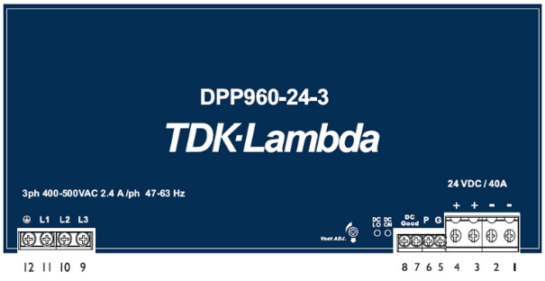
Connecting DPP960 models in parallel
Parallel connection of power supplies
Ensure that the units to be connected in parallel (up to 2) have the same output voltage
For optimum sharing, please keep the load cables similar in length and gauge
Connect the outputs with the load
Connect the "parallel“ terminals,
use twisted wires
Parallel operation 10% - 90% of nominal
output current with a maximum of 2 units
connected.
+ -
Load
Copyright© 2011 TDK Corporation. All rights reserved.

Slide 5
Connecting HWS 300 - 1500 models in parallel
Parallel connection of power supplies
Ensure that the units to be connected in parallel (up to 5) have the same output voltage
For optimum sharing, please keep the load cables similar in length and gauge
Connect the outputs with the load
Connect the "PC" and "COM" terminals, use twisted wires
Remove "COM" connection if sense function is used, use twisted wires
+ S
+ S
+ Vm
+ Vm
PC
COM
-Vm
Load
PC
COM
-Vm
Load
-S
-S
PC
COM
+ S
PC
COM
+ S
+ Vm
+ Vm
-Vm
-Vm
-S
-S
Copyright© 2011 TDK Corporation. All rights reserved.

Slide 6
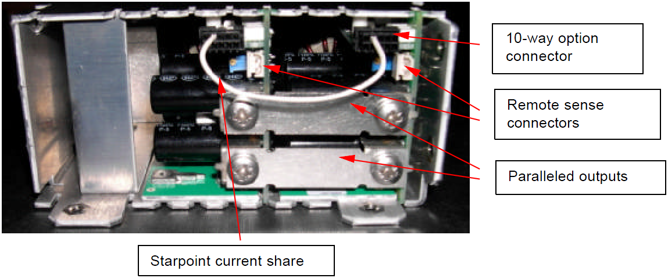
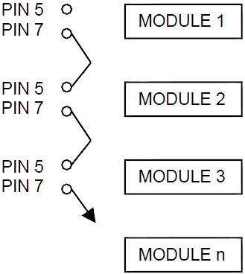
Connecting Vega modules in parallel
Parallel connection of power supplies
Nearly all Vega modules can be connected in parallel
Add the N - option for modules to be connected in parallel, for example 5E2SN
Order factory paralleled Z - modules (Z2, Z3, Z4 …Z19)
It's possible to connect more than 2 modules in parallel by using starpoint current share
It's also possible to connect modules from different Vega units in parallel
or
Copyright© 2011 TDK Corporation. All rights reserved.

Slide 7
Series connection of power supplies
Series connection of power supplies
Use only power supplies of same type and ratings
Connection to get double voltage on the load
Outputs above 60Vdc are considered to be non SELV
Sometimes additional diodes are necessary (read instruction manual)
Connection to get a plus / minus source for two loads
Connection to get a plus / minus source for common ground loads
Some types of power supplies allow more than 2 units to be connected in series (read instruction manual or ask our support)
Load
Power Supply 1
48V
Power Supply 1
24V
Load
96V
± 24V
Ground
Load
Power Supply 2
48V
Power Supply 2
24V
Copyright© 2011 TDK Corporation. All rights reserved.

Slide 8
Questions?
Distributors Technical Training
THANK YOU!
Copyright© 2011 TDK Corporation. All rights reserved.

Slide 9


